Slide 1
Test Taking and Studying Strategies
The University of Louisiana at Lafayette
Office of Disability Services

Slide 2
Study Habits Self Check
I forget what I studied when taking a test.
I wait until the last minute to study.
I blank out or freeze during tests.
I feel rushed when taking tests.
I don’t score well on multiple-choice tests.
I don’t do my best on essay tests.
I don’t do well on problem-solving items.
I rarely take practice tests.
Notes:
You can use this self check to figure out where you most need to focus your growth as a learner.

Slide 3
Mindfulness Studying
Anxiety affects attention, which affects ability to consolidate and store memories, as well as ability to recall memories.
Mindfulness, or “paying attention on purpose” and calmly acknowledging and accepting your feelings, can be the study aid you never knew you needed.
Check out this website to see a short video presentation on how test anxiety affects the brain and suggestions for mindfulness practices that can help.

Slide 4
Who Should You Study With?
*Should you study by yourself or with others?
Those who get confused or doubt themselves when studying with others are better off studying alone.
Those whose learning styles indicate that they are social learners are better off studying in a group (or at least with one other person).
Try this self assessment to learn your learning style and get advice on how to study according to your learning style!

Slide 5
How Should You Study?
Use soft, non glare lighting
Non distracting sights/sounds
Electronic Lockdown
Clear working space
Find accessible materials/resources
Study Divided into Smaller Chunks
Don’t procrastinate
Create a study plan checklist to keep you on track
Take Frequent, Short Breaks
Know the format of the test--Multiple Choice, Essay, Etc.
Notes:
Choosing the best place for you to study is very important. Here are a few suggestions for choosing the best study environment for you!
Electronics can sometimes be what distracts us the most. Put your social media on mute, take off your smart watch. Dedicate the time you have to studying.

Slide 6
Preparing for a Test
Review the topics on the syllabus.
Your instructor may mention topics that will be on the exam in class (or you can ask). Listen to clues from your instructor such as: “Write this down” “Let me summarize” “Let me say it again” “This is important” “Remember…”
Are details like names and dates important to study or are the “big concepts” (e.g., the consequences of the Civil War on the United States) more important to know?
Ask the instructor if you are “on the right track” with your study plan. Ask whether you should focus more on the book or notes. (Don’t always get an answer to this question but it is always worth asking!).
Some final exams are “cumulative”. This means that they cover material from the beginning of the semester. Therefore, it is important to keep all previous tests that are handed back to you to study from. However, there are many classes where tests are reused, and so students do not get them back. If tests are not returned to you, make an appointment with the instructor to review your tests.

Slide 7
Preparing for a Test
If using a textbook, implement active reading strategies such as:
Review the chapter and section headings and convert them to a question. For example, the header, “Causes of World War I” might be changed to “What are the causes of WWI?”
Review the words, phrases, and sentences that appear in bold type.
Study the pictures, tables and sidebars for information.
Review and answer questions at the end of the chapter.
Use colored highlighters or Post-it notes to flag important information.
Draw cartoons or pictures
Create crazy phrases for remembering things in order? My Very Eager Mother Just Served Us Nine Pizzas (Mercury, Venus, Earth, Mars, Jupiter, Saturn, Uranus, Neptune, Pluto)
Create Acronyms: ROY G BIV (Red Orange Yellow Green Blue Indigo Violet)
Use word associations: If something is distinct it may have a distinct or “stink” smell. Stink is Distinct

Slide 8
How to Study for a Multiple Choice Test
-Note Card Strategy
Summarize and put information on note cards (works best for definitions of new vocabulary or concepts and lists of processes)
Group note cards by topic or some other similarity to make it easier to study from them.
Don’t just study individual cards or facts; make associations/connections between them.
If you prefer to use an online version of notecards try check out Quizlet.
-Elimination Strategy
Read each question carefully.
Cover up the possible responses with a piece of paper or your hand and attempt to recall the correct answer.
Unveil the choices and if the response that you thought is there as an option, circle it and then check to see if any of the other responses make more sense.

Slide 9
How to Study for a Multiple Choice Test
Crazy Phrase Memory Strategy
Slash the Trash: Read ALL of the choices. Get rid of any choices you know for sure are wrong. Put a question mark beside the ones you want to consider. Choose the BEST answer from what is left.
“Jail” the Details:Highlight, underline, or circle the details or key words in the questions.
Be Slick and Predict:Predict what the answer is BEFORE you read the choices. Select the choice that is closest to your answer.
Plug It In:Read the answer choices, and plug each choice in to see if it fits. Ask yourself, “Does this make sense?”
Tick Tock…Mind the Clock: Don’t stay stuck on one question. Take your best “thinking guess” and move on. Make a note of the question so that you can go back to it if you have time.

Slide 10
How to Study for an Essay or Short Answer Test
Review study guides, powerpoints, notes, practice tests, textbooks and predict what will be a likely short answer or essay question and make a list of those ideas. If you don’t get a study guide, ask yourself questions that your professor might ask. Include “What”, “Who”, “Where”, “When” and (especially) “How” and “Why” questions. Writing down the answers to your questions becomes your own study guide. On a History exam for example topics could include:
The impact of European discovery and colonization upon indigenous societies.
The origins and nature of slavery and resistance to it
The history of women, changing gender roles, and family structures
The development and character of colonial societies
British relations with the Atlantic colonies of North America
The changing role of religion in American society
Plan your essay questions ahead by using maps or three-column organizers. Check out the PDF of free graphic organizers to start you off.
Notes:
A graphic organizer is a way to visually organize your ideas. It can help put your thoughts into place and help you see information at a glance. Organizers can also help you see how ideas are connected, where they might fit into your paper, and where they may need further development. Graphic Organizers are used for studying not on the actual test day.

Slide 11
How to Study for an Essay or Short Answer Test
Notes:
This is an excellent strategy for creating both short answer paragraphs and full essays. It includes all of the elements you would need to get the best score possible!

Slide 12
How to Study for a Math Exam
Practice what you are learning by completing homework problems and extra example problems, if necessary, for you to understand the process and the formulas needed.
Math classes are usually cumulative – every new topic builds upon what you have learned previously. Because of this, it is important not to wait until the last minute to learn all the material. As you learn a new topic, check to see how it relates to something you have already learned.
Be aware that college courses in math usually require you to apply your skills to familiar and unfamiliar types of problems instead of just memorizing a problem type or formula.

Slide 13
Apply Pólya's Four-Step Process
What quantity is the problem asking you to solve?
Which skills, procedures or formulas can be used to solve the problem?
Solve the problem.
Review your solution. Does it seem reasonable? If not, review the steps you took to solve the problem to check for mistakes.
From: George Pólya, How to Solve It, Princeton University Press, Princeton (1945)

Slide 14
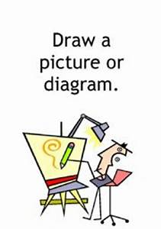
Other Alternative Problem Solving Techniques
Draw a picture or a diagram of the problem.
Make a list of steps.
Work the problem backward from the answer.
Try to “reason it out”.
Try alternative example problems of the same type.

Slide 15
How to do “Word Problems/Applied Problems”
Convert the problem into mathematics.
Draw a picture and label it with all the quantities (numbers or variables) mentioned in the problem. In order to finish converting the problem into mathematics, find equations which describe relationships among the variables, and describe the goal of the problem mathematically.
Solve the problem you have come up with using the four-step process above or other problem-solving strategies.
Once you have solved the problem mathematically, convert the math back to words so that you have now solved the original applied problem.

Slide 16
Managing Your Time with Extended Test Time Accommodations
Extended time does NOT mean unlimited time. Thus, you still need to be able to manage your time when you take an exam with extended time.
Try not to spend too much time on one question (know when to “let go”).
Know how much time to spend on each question by noting how many points the question is worth.
Plan to spend a few minutes before the test reviewing the test and some time after you have finished the test to review your answers before handing it in.
If you tend to be impulsive and choose the first answer you see, it is important to review your answers at the end of the exam.
However, if you tend to “second guess” yourself and talk yourself out of the correct answer, then just review the questions that you were really not sure about.

Slide 17
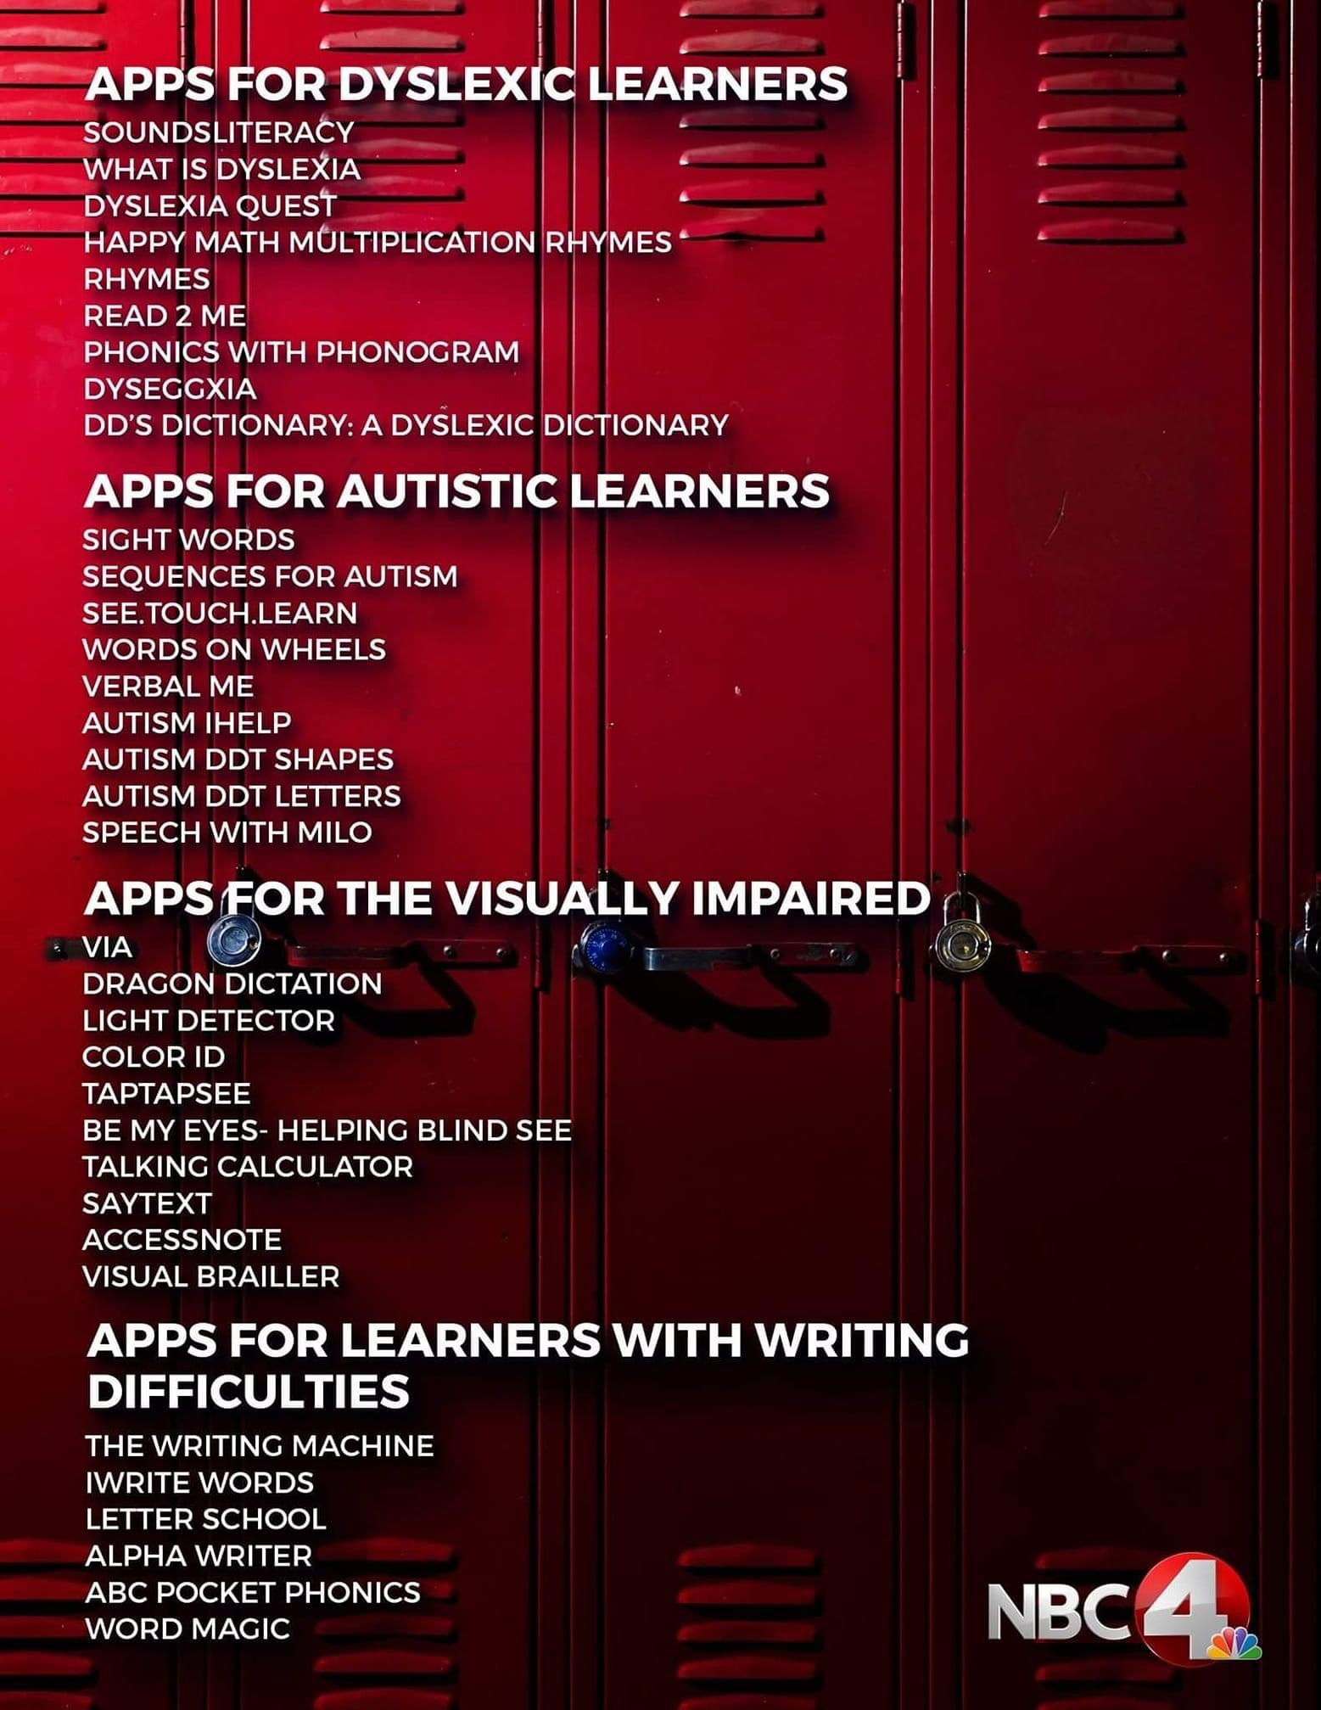
Additional Resources: Apps

Slide 18
Student Support Services-Disability
If you need tutoring services or help with any of these strategies, visit the Student Support Services-Disability.
Location: Agnes Edwards Hall (The Old Conference Center) Room 122
Phone: (337) 482-1410
Website: Student Support Services-Disability

